Slide 1
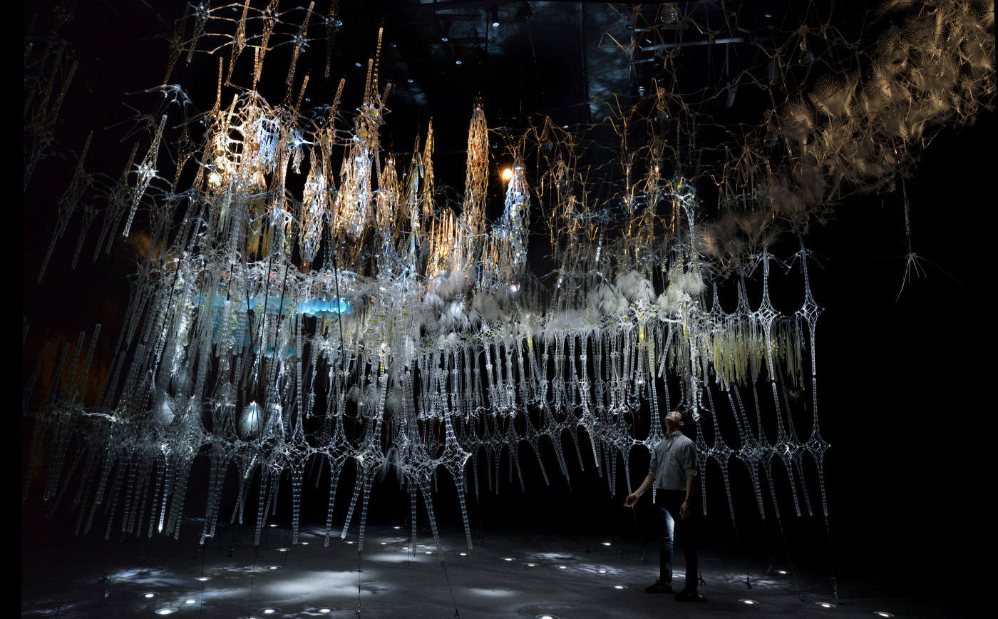
Curiosity-Based Learning Algorithm for Interactive Art Sculptures
Image courtesy of Philip Beesley Architect Inc.
Matthew Tsz Kiu Chan Feb 09, 2016

Slide 2
Outline
Introduction
Curiosity-Based Learning Algorithm
Interactive Control System
Experimental Validation
User Study
Conclusions and Future Work

Slide 3

Motivation
Part of the Living Architecture Systems Group (LASG).
Aims to create large-scale interactive architectural installations that exhibit life-like qualities (Beesley, 2012; Gorbet, 2015).
Notes:
We are part of LASG.
PBAI made architectural scale installation.
Want to find out if architecture can be alive.

Slide 4
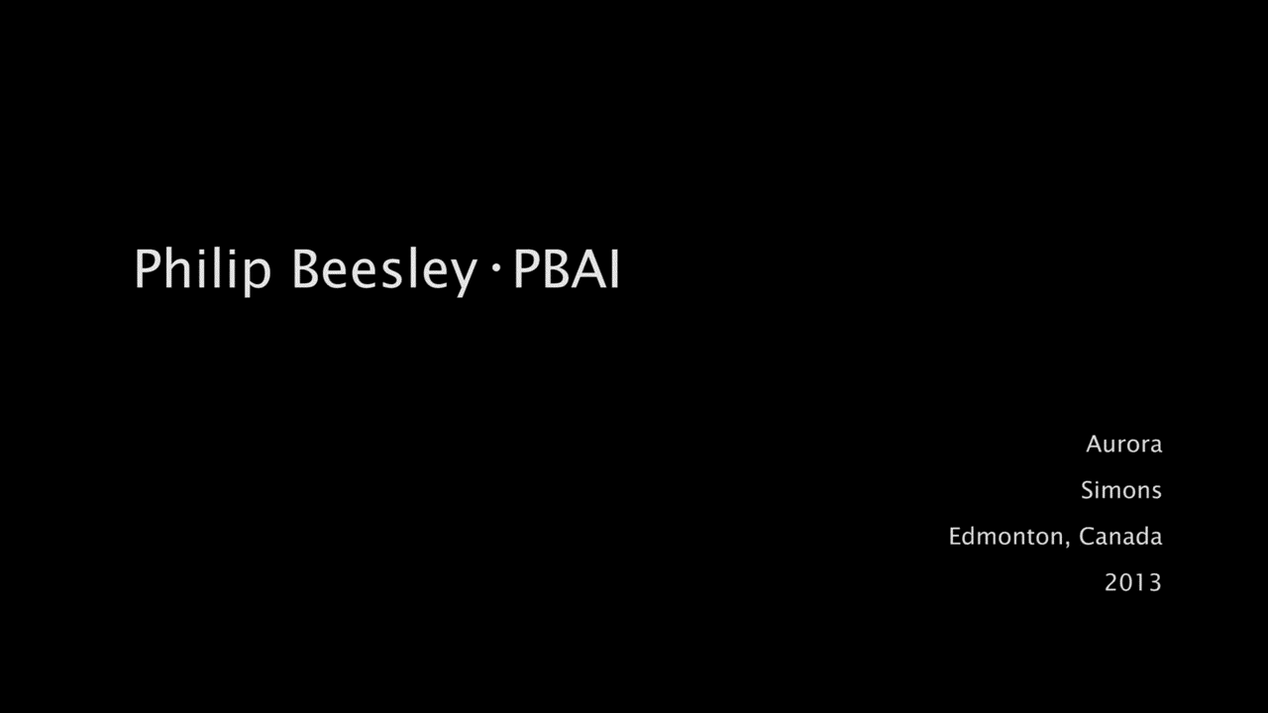
Aurora Interactive Sculpture
https://vimeo.com/109144234
Notes:
Aurora in West Edmonton Mall.
IR detects → spiral LED → overlapping actuation
Non-overlapping still. Want sculpture to generate its own behaviours.
Designer don’t dictate what is considered interesting or life-like.
Don’t have to program coordinated behaviours.

Slide 5
Objectives
To enable the sculptural system to generate varying behaviours autonomously.
To characterize these autonomous behaviours and the system’s responses to human interactions.
To study the responses and perceptions of the users.
Notes:
Generate varying behaviours on its own and not programmed by people. This more life-like.
Characterize the behaviours emerged when interesting with human.
Study how people see it.

Slide 6
Approach
Introduce the Curiosity-Based Learning Algorithm (CBLA)
Recasts the sculptural system as a set of agents driven by an intrinsic desire to learn.
Based on the Intelligent Adaptive Curiosity (IAC) algorithm (Oudeyer, 2007).
Build an experimental test bed implementing the CBLA
Conduct experiments and user study on the test bed
Compare results under different configurations and against the non-varying prescripted behaviours.
Notes:
Generate varying behaviours by mimicking curiosity.
CBLA adapted from IAC.
Reinforcement learning algorithm with expected learning progress as reward.
Studying the action generated in the learning process; not trying to use the learnt model.
Build a test bed that implement the CBLA.
Test it on its own and with users.

Slide 7
Contributions
An algorithm for generating autonomous behaviours for a large scale kinetic sculptural system during interaction with an occupant was developed.
A test bed including new electronic hardware and software architecture was built to enable physical realization of the approach.
A user study was conducted to examine how human occupants perceive the behaviours of the sculpture and respond in turn.
Notes:
CBLA Algorithm.
Test bed hardware and software to run CBLA.
User study examining user’s perceptions.

Slide 8
Introduction
Curiosity-Based Learning Algorithm
Interactive Control System
Experimental Validation
User Study
Conclusions and Future Work

Slide 9
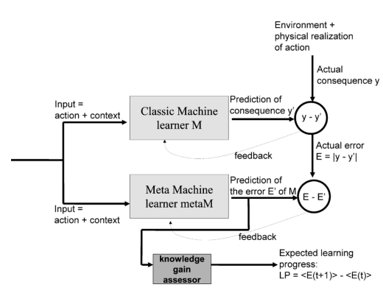
Intelligent Adaptive Curiosity (IAC)
Oudeyer, P., Kaplan, F., & Hafner, V. V. (2007). Intrinsic motivation systems for autonomous mental development. IEEE Transactions on Evolutionary Computation, 11(2), 265-286
classM predicts consequence of action given context.
metaM predicts error in classM’s prediction.
LP is the expected reduction of error in similar sensorimotor context.
Notes:
classM and metaM.
LP is the reward to the reinforcement learning algorithm in this case.
The expected is the average of the most recent few prediction errors
The actual errors in the past are the average of previous error a few time steps ago.

Slide 10
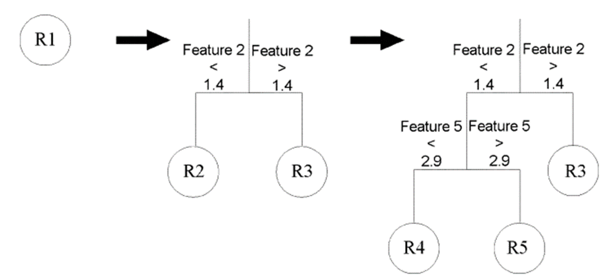
Intelligent Adaptive Curiosity (IAC)
Oudeyer, P., Kaplan, F., & Hafner, V. V. (2007). Intrinsic motivation systems for autonomous mental development. IEEE Transactions on Evolutionary Computation, 11(2), 265-286
The state-space splits into regions over time.
Each region represents a set of similar sensorimotor context.
Learning progress is evaluated within each region.
Agent selects actions with the highest expected learning progress.
Notes:
Start with one region; split over time.
Region == sensorimotor context.
Learning progress evaluated in similar situation.
Robot select action with max LP.

Slide 11
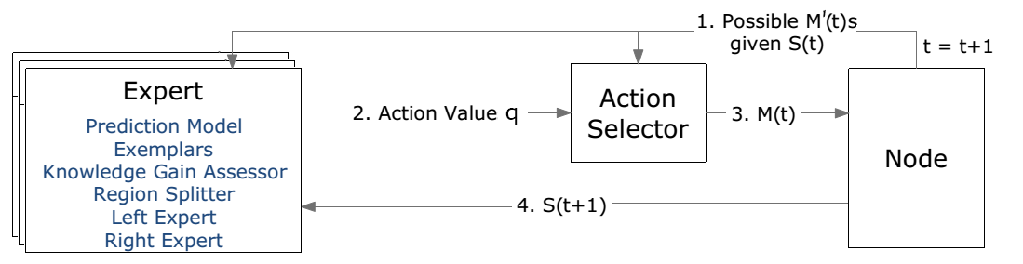
Curiosity-Based Learning Algorithm (CBLA)
CBLA adapts the IAC algorithm for a distributed kinetic sculpture which has hundreds of sensors and actuators.
Each Node
represents a subset of the system.
has a CBLA Engine made up of an Action Selector and a set of Experts.
starts with one Expert and splits into more regions over time.
Notes:
IAC → a single robot with a handful of input and output variables.
CBLA → a larger system with hundreds of actuators and sensors.
Split the system into multiple Nodes. Otherwise, state-space too big.
CBLA steps.

Slide 12
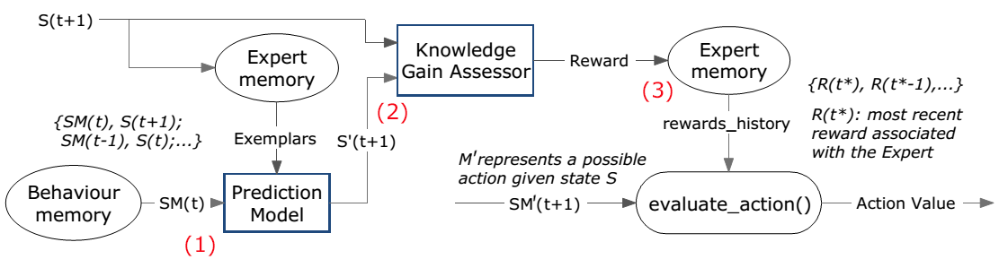
Experts
An Expert associated with the current sensorimotor context is selected to make a prediction of the consequence S’(t+1).
The reward is evaluated by the knowledge gain assessor.
The Action Selector queries the Expert for the action value associated with its sensorimotor context.
Notes:
Expert make prediction using linear model.
KGA evaluates the rewards.
An action value associated with an Expert.

Slide 13
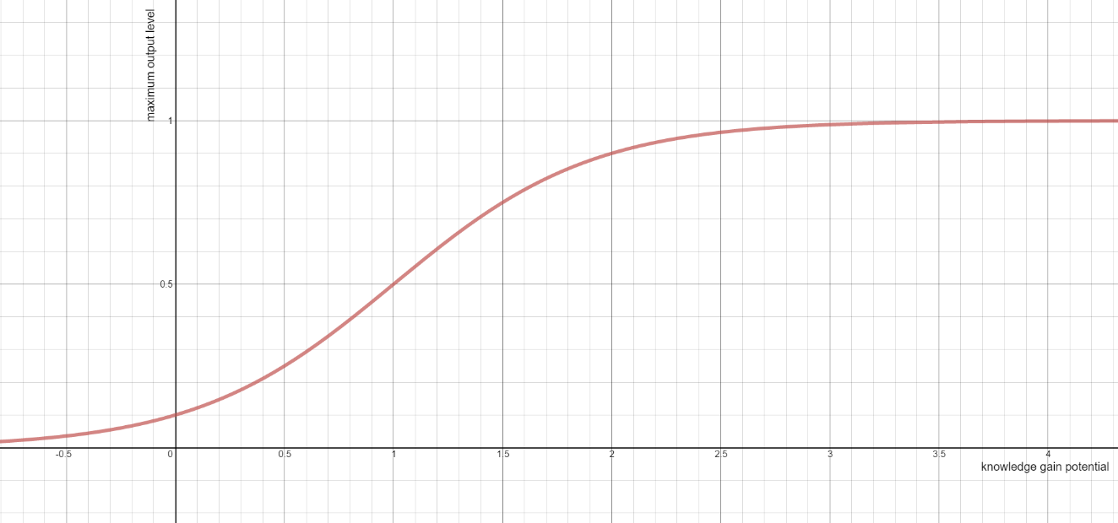
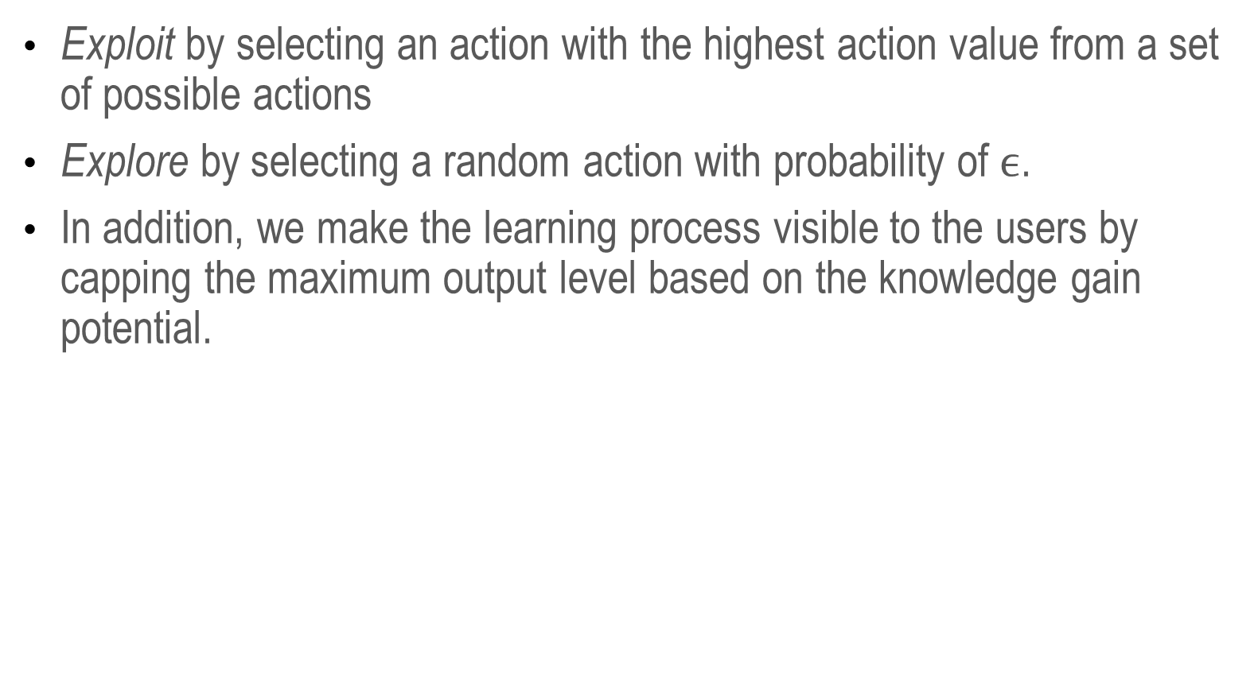
Action Selector
Exploit by selecting an action with the highest action value from a set of possible actions
Explore by selecting a random action with probability of $ϵ$.
In addition, we make the learning process visible to the users by capping the maximum output level based on the knowledge gain potential.
Notes:
E-greedy action selection metho.
Make learning process visible by adjusting max output.
Analogous to being bored.

Slide 14
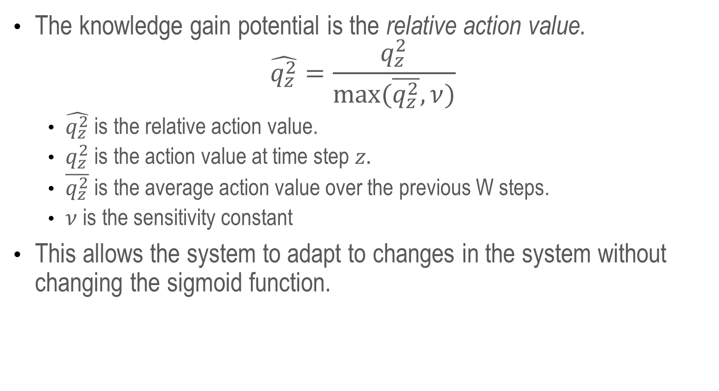
Action Selector
The knowledge gain potential is the relative action value.
$$\hat{q_{z}^{2}}=\frac{q_{z}^{2}}{max⁡(\overline{q_{z}^{2}},ν)}$$
$\hat{q_{z}^{2}}$ is the relative action value.
$q_{z}^{2}$ is the action value at time step $z.$
$\overline{q_{z}^{2}}$ is the average action value over the previous W steps.
$ν$ is the sensitivity constant
This allows the system to adapt to changes in the system without changing the sigmoid function.
Notes:
Relative action value adapts to different inherent noise.
Sensitivity constant affects sensitivity to noise.

Slide 15
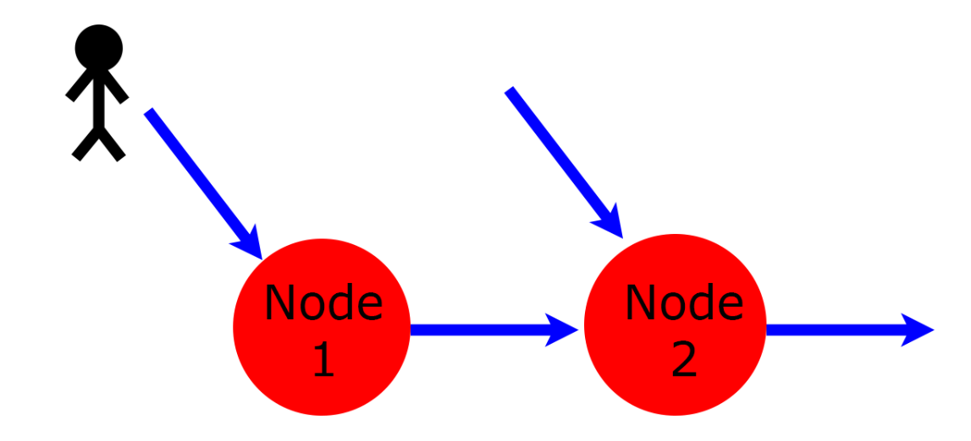
Multi-Node CBLA System
Subset of related variables are grouped into Nodes with each running its own instance of the CBLA Engine.
Each Node runs independently and asynchronously.
Nodes are connected to each other via shared inputs and virtual inputs.
For example, Node 2 can detect changes not covered by its own sensors indirectly through Node 1.
Notes:
Make state-space smaller.
Loop period → bandwidth of actuator.
Shared inputs.
Virtual inputs → indirect information.
Separating the into multiple Node, the state space of the CBLA Engine can be smaller. In addition, their loop period can be adjusted to the bandwidth of their underlying actuators.

Slide 16
Introduction
Curiosity-Based Learning Algorithm
Interactive Control System
Experimental Validations
User Study
Conclusions and Future Work

Slide 17
Interactive Control System
New Hylozoic Series 3 was developed in order to implement the CBLA system.
CBLA system requires a large number of sensors and actuators and computational power that previous series of the electronics system were unable to provide.
Most computations are moved to a central computer; it communicates with the microcontroller via USB.
This also allows high-level abstraction of the sculptural system.
Notes:
Old system didn’t have the capability.
Move computation to PC make things easy.
High-level abstraction possible.

Slide 18
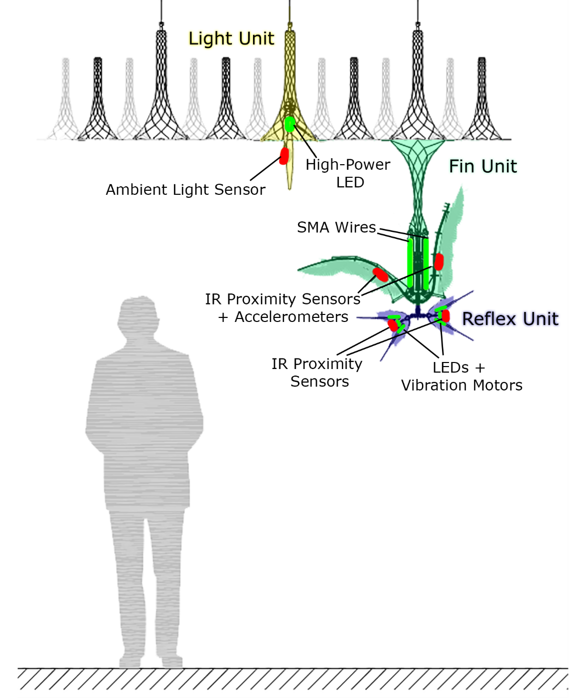
Hardware Components
Notes:
Actuators and sensors.
CBLA Nodes don’t confine to physical.

Slide 19
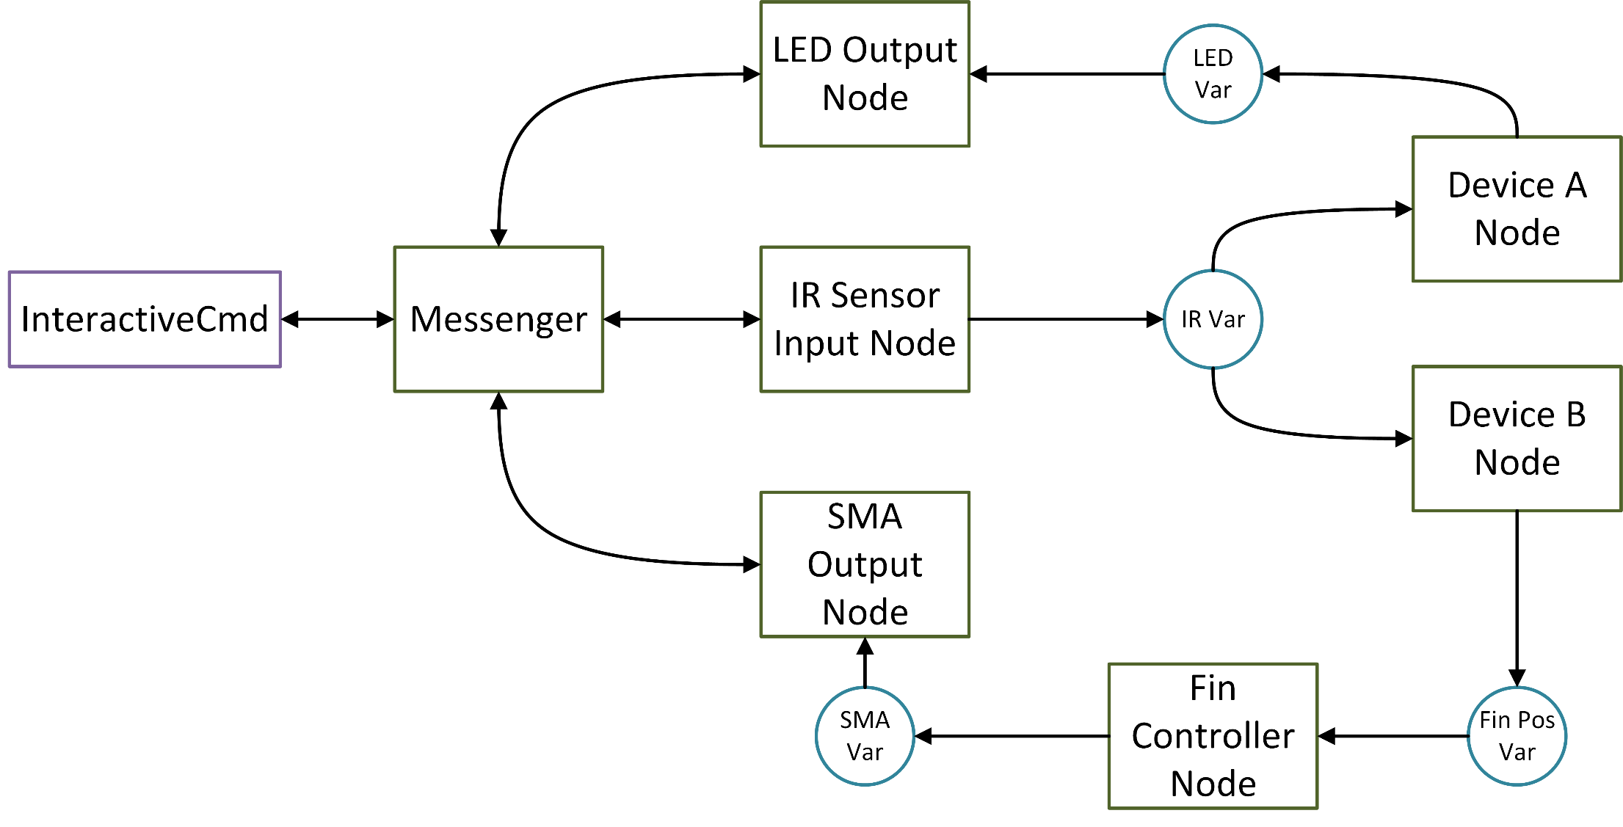
Node Abstraction
Notes:
Messenger talks to microcontrollers.
Nodes that represents actuators and sensors.
Nodes that made up of other Nodes
CBLA Node is a Device Node.

Slide 20
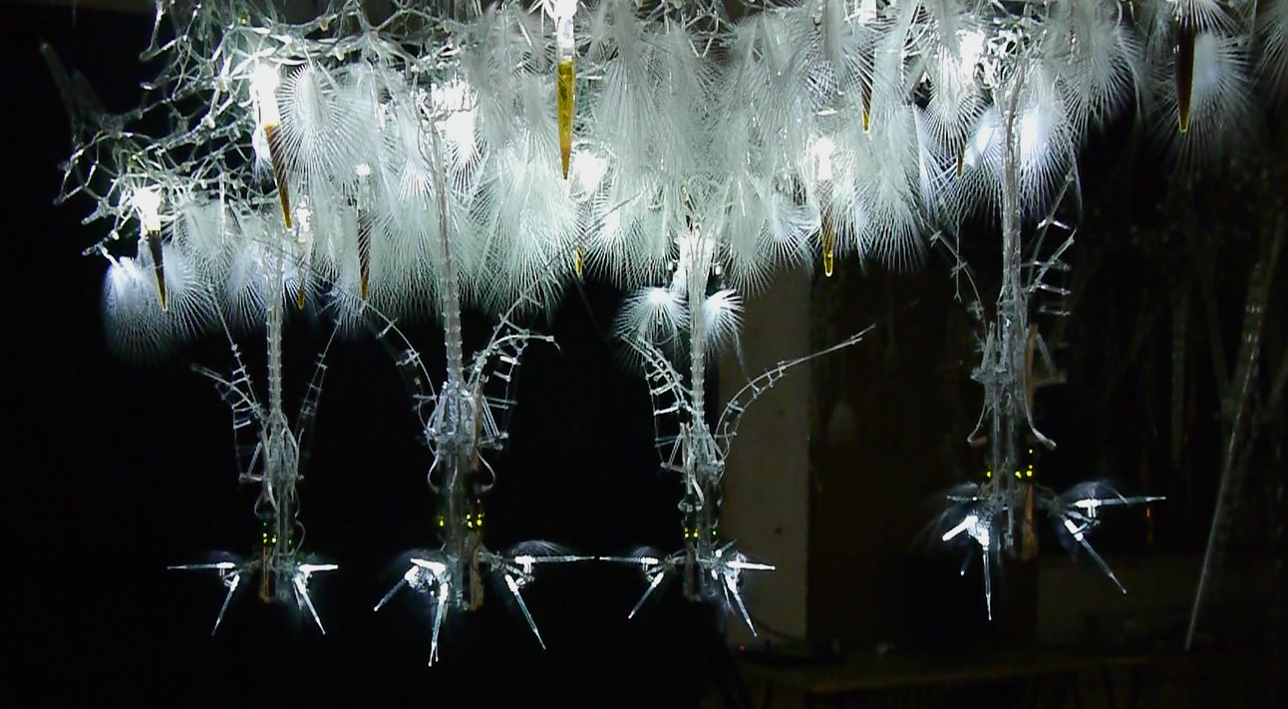
Experimental Test Bed
Notes:
Four clusters. Three sets of each.
Smaller than typical installation however.
It is used for user study.

Slide 21
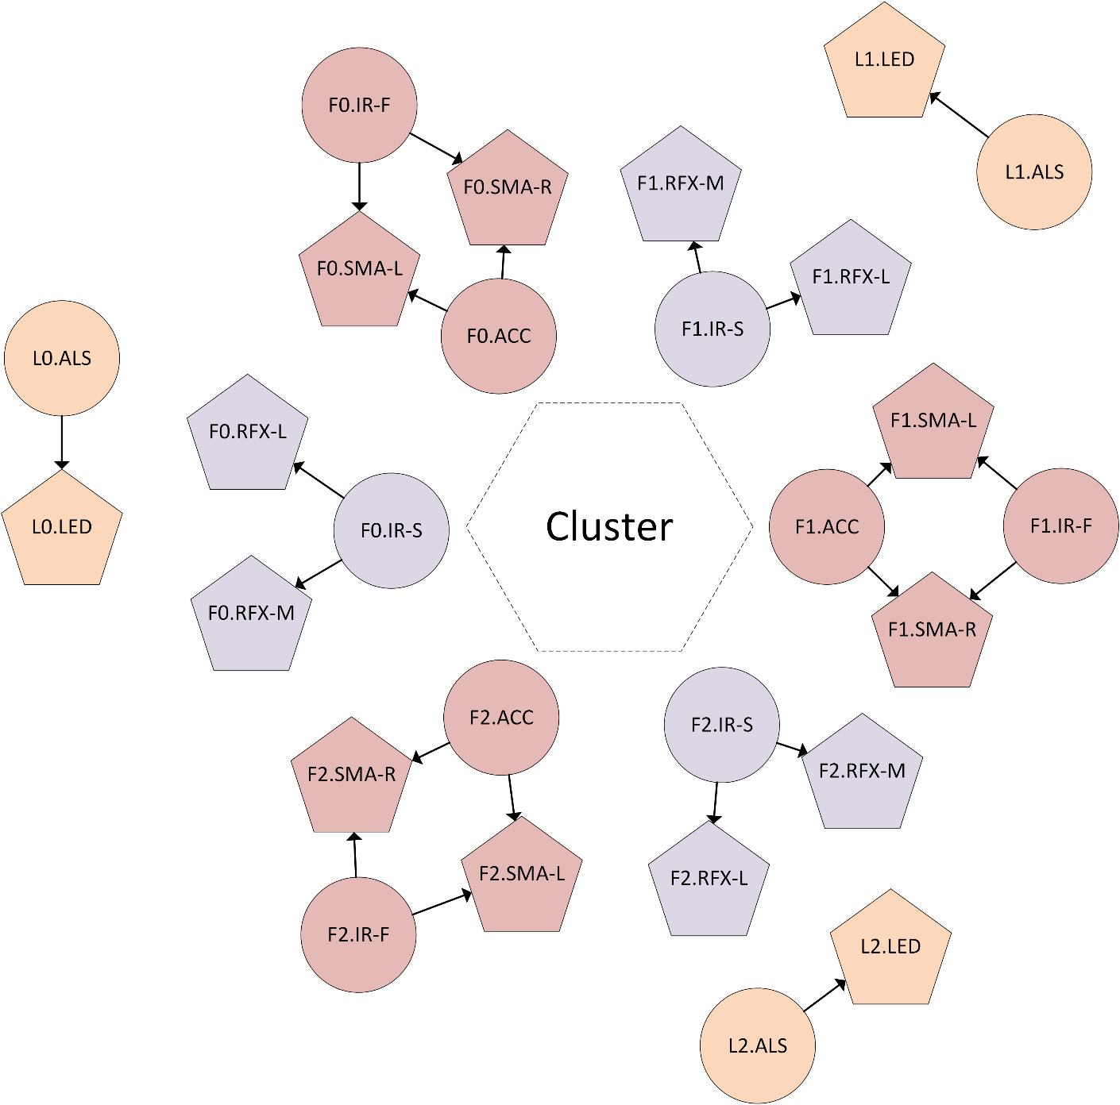
CBLA Nodes
Three types of CBLA Nodes
Half-Fin
Light
Reflex
CBLA Nodes were connected either in Spatial Mode or Random Mode.
Notes:
Three types of CBLA Nodes.
Each actuator per CBLA Node.
Spatial Mode and Random Mode.

Slide 22
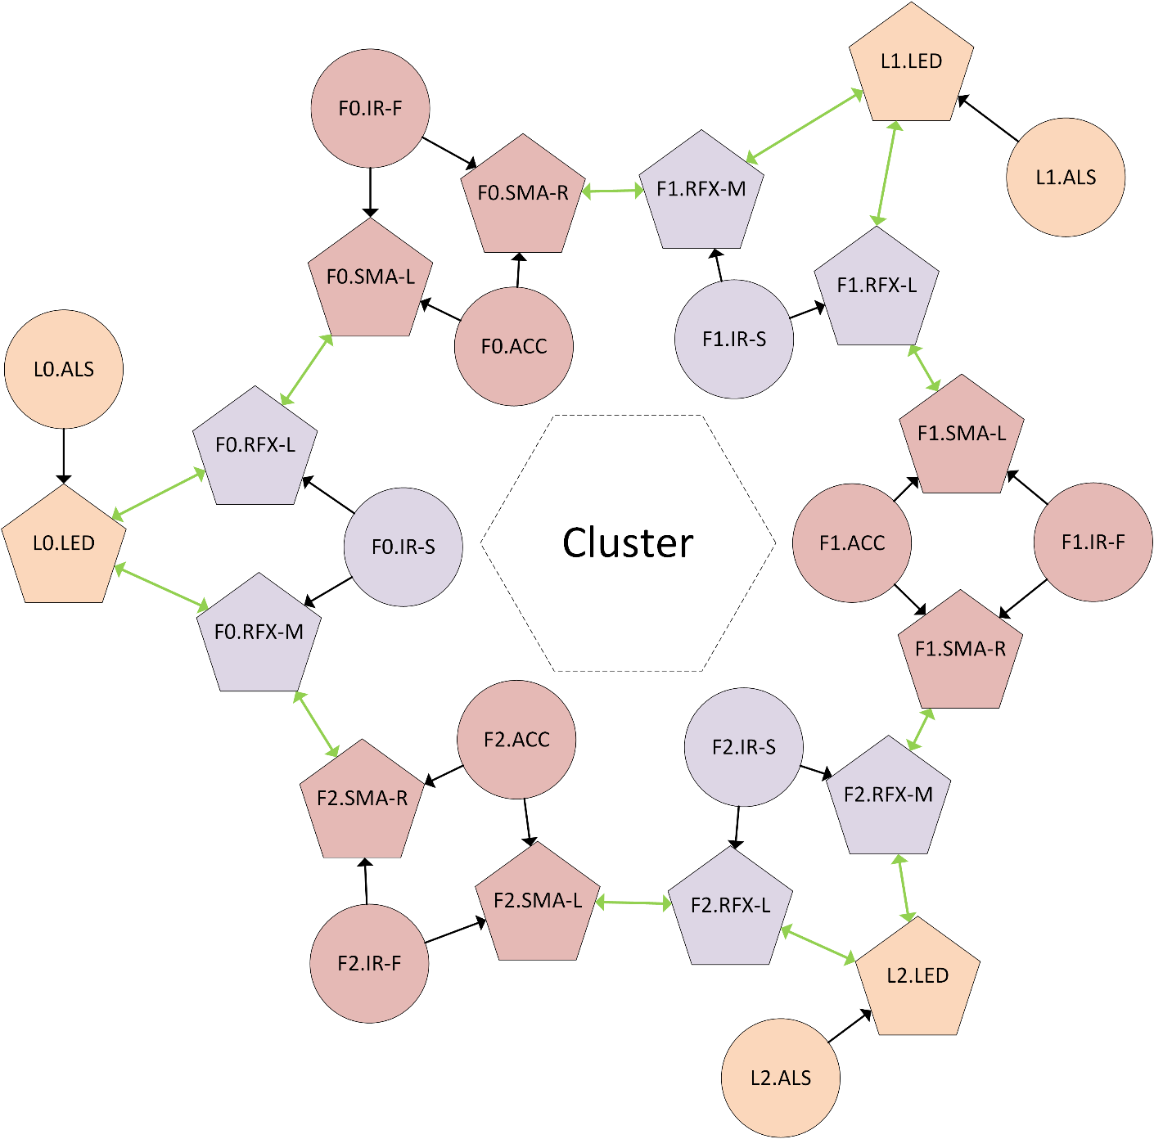
Spatial Mode
Output of a Node is a virtual input of a neighbouring Node.
Notes:
Virtual input by proximity within a cluster.

Slide 23
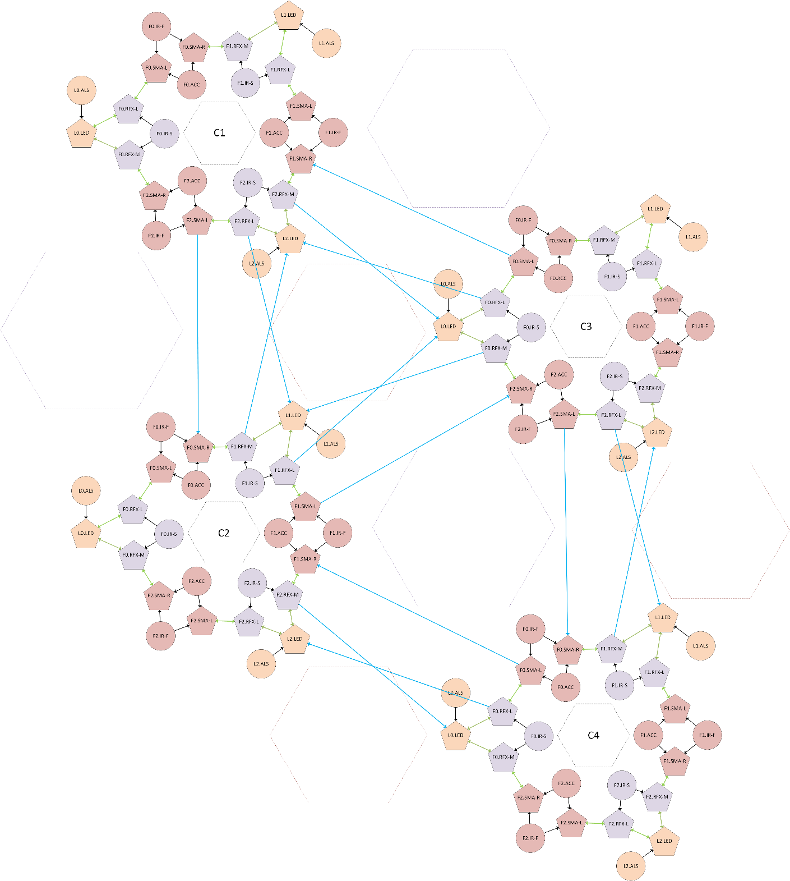
Spatial Mode
Nodes in nearby clusters are also connected via virtual inputs.
Notes:
Also link to Nodes in neighbouring clusters.
Random Mode -> random, uniform links.
111 links in total

Slide 24
Prescripted Behaviours
Fin: bends down, left, or right based on its associated IR sensors.
Light: ramps up when its associated Fin-mounted IR sensor detects an object.
Reflex: ramps up when its associated bottom-mounted IR sensor detects an object.
An actuator may also activate spontaneously at a probability that is related to the number of activated actuators in the cluster.
Notes:
Responsive behaviours
Probabilistic behaviours.

Slide 25
Introduction
Curiosity-Based Learning Algorithm
Interactive Control System
Experimental Validation
User Study
Conclusions and Future Work

Slide 26
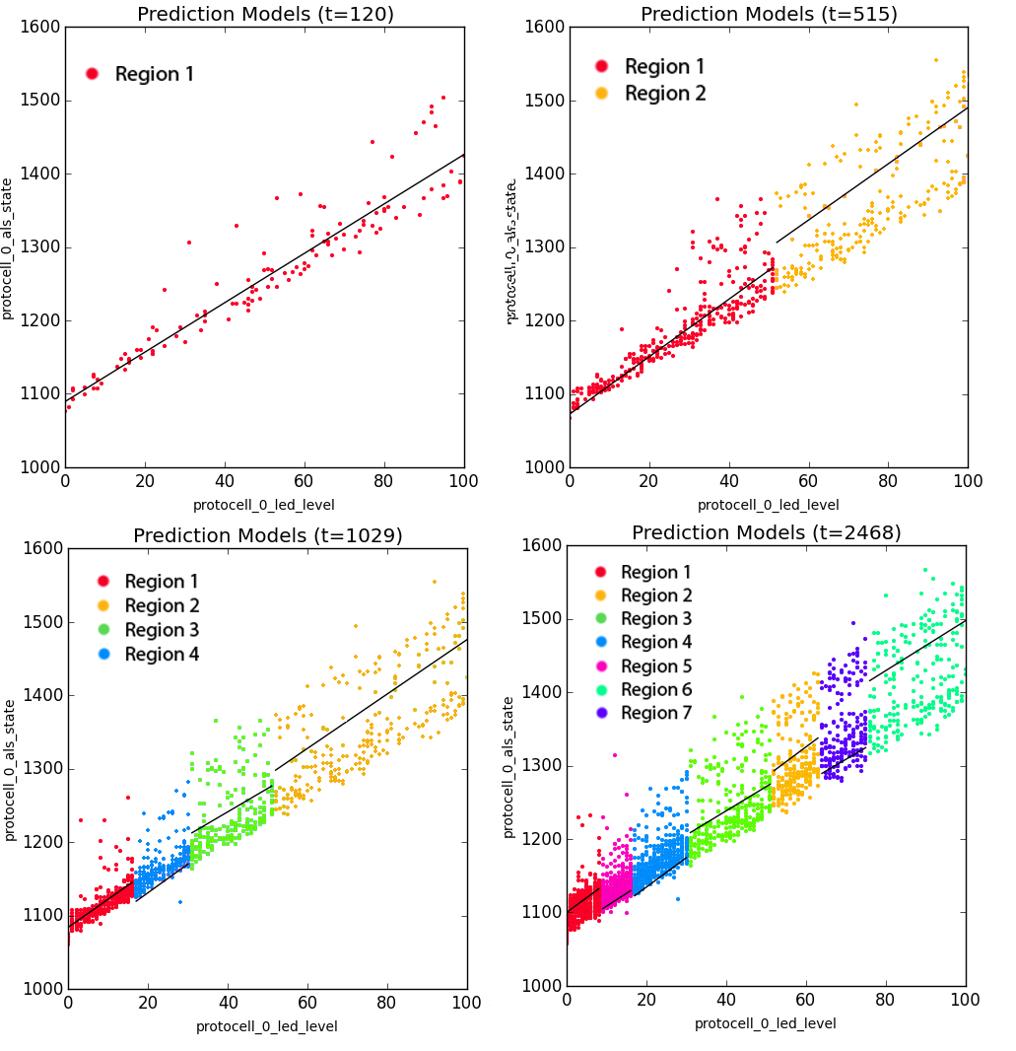
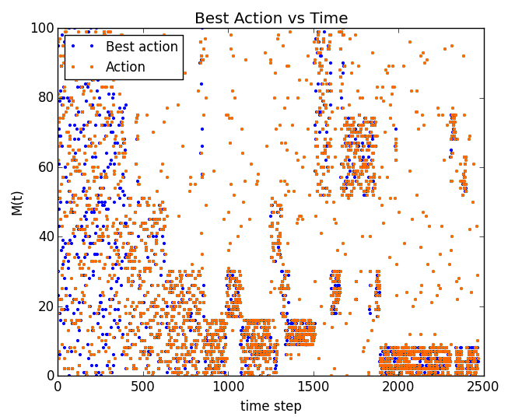
Exploration pattern of a Single Node System
A single CBLA Node with LED level as output and light intensity level as input.
CBLA explores lower variance regions before exploring higher variance regions.
Notes:
Output → LED; Input → ambient light sensor.
Higher variance in the high brightness regions (considered more difficult at first).
Split it easy regions before hard.

Slide 27
Multi-Cluster Experiment
“Single Trigger” procedure
An object was placed in front of an IR sensor in Cluster 3 at the 450s point.
“No Trigger” procedure
Undisturbed in the entire experiment.
Experimented on combinations of Spatial Mode/Random Mode and low sensitivity/high sensitivity.
Hypothesis: activations of Spatial Mode should be more concentrated around the trigger location than Random Mode.
Hypothesis: the magnitude of activations of the trials using low-sensitivity setting would be more dampened compared to the high-sensitivity setting.
Notes:
Reaction to single disturbance at 450s.
The trigger becomes new info that it wants to learn.
In Spatial Mode, the trigger should concentrate closer to trigger.
Low intensity with low sensitivity.

Slide 28
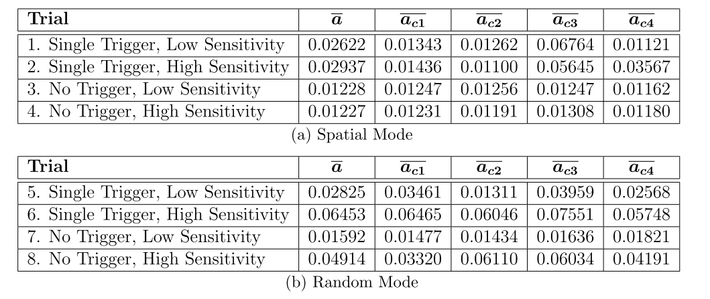
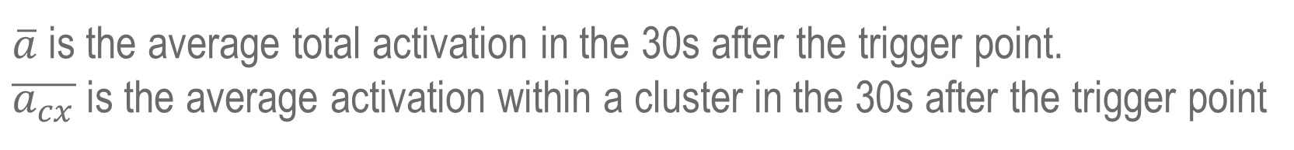
Activation Levels
$\overline{a}$ is the average total activation in the 30s after the trigger point.
$\overline{a_{cx}}$ is the average activation within a cluster in the 30s after the trigger point
Notes:
Average activation in the 30s after the trigger.
Total activation is higher for Random Mode.
C3 has larger difference from Total activation for Spatial Mode.
The activation is lower for low sensitivity.

Slide 29
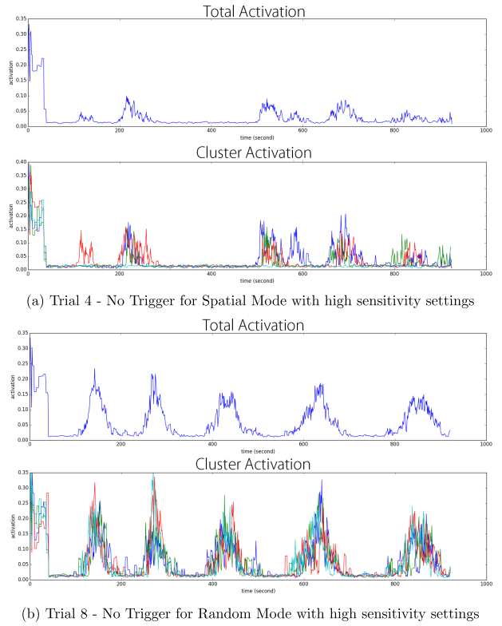
Spontaneous Activations
Notes:
Activation pattern without trigger.
More inter-cluster links → more uniform patterns.
Believe higher activation is better even if non-triggered. Can attract attentions.

Slide 30
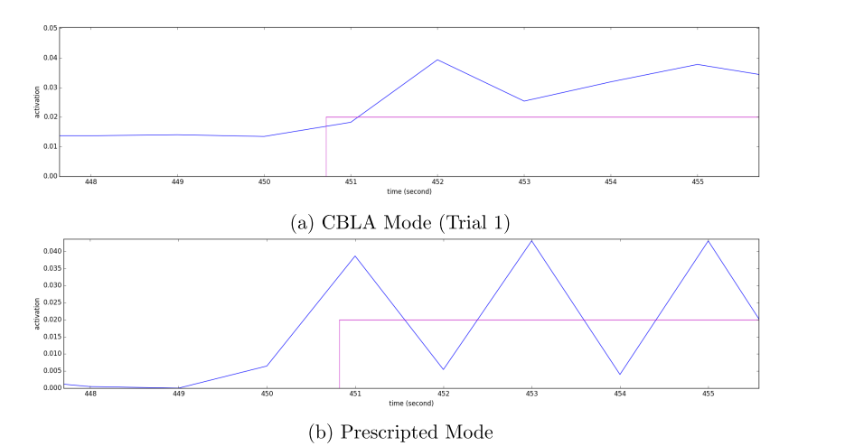
Response Time
Notes:
Small delay with CBLA.
Might affect perceived responsiveness.

Slide 31
Introduction
Curiosity-Based Learning Algorithm
Interactive Control System
Experimental Validation
User Study
Conclusions and Future Work

Slide 32
Research Questions
Does the use of the CBLA increase users’ interest level over prescripted behaviours?
Do people perceive CBLA as non-random?
Are certain behaviours more interesting than others?
Notes:
CBLA more interesting because it’s more novel and varying.
CBLA should be perceived as non-random.
Some behaviours may be more interesting in general (high activation, proximal)

Slide 33
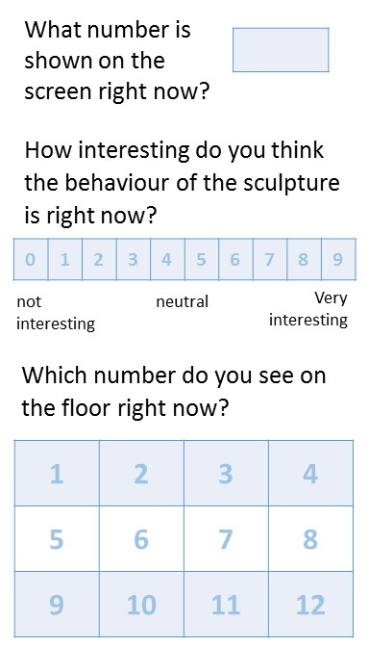
User Study Procedure
The participant interacts with the sculpture running Spatial Mode with high sensitivity setting for 20 min.
During the trial, participants are asked to fill out a questionnaire card 8 times.
In the middle of the trial, the behaviour will switch from CBLA Mode to Prescripted Mode or vice versa.
The participant fills out an exit survey after the trial.
Notes:
Interact any way for 20 min.
Full in 8 cards when beep.
Switch from CBLA Mode and Prescripted Mode in the middle.
Exit survey at the end.

Slide 34
Results
CBLA Mode was reported to be 25% less interesting than Prescripted Mode.
Reported interest level increased by 33% when switched from CBLA Mode to Prescripted Mode.
Moderate positive correlation was found between perceived responsiveness and interest level.
CBLA Mode tends to be described as “random” or “unresponsive”
Weak positive correlation was found between overall activation levels and interest level. Proximal activation didn’t show stronger positive correlation.
Notes:
CBLA less interesting.
Especially less interesting when switch from CBLA to Prescripted.
Positive correlation found between responsiveness and interest level.
CBLA Modes seems random.
Activation level correlate with interest level. But proximal not particularly strong.
The test bed is small.

Slide 35
Discussion
Are life-like behaviours interesting?
Several participants commented that, during the trial, they tried to discover the responsive behaviours of the sculpture.
Harder to observe causal relationship when behaviours are varying and often activate autonomously. Thus, the sculpture appears less predictable.
Did delays in the response of the CBLA make it less interesting?
Would participants who have better understanding of concepts behind the work find it more interesting?
The trials may be too short.
The user interactions in this user study may not be representative of interaction in a typical exhibition setting.
Categorization of participants might be necessary to discover more useful information about user response to different kinds of behaviours.
Notes:
Interesting if novel and comprehensible.
Being life-like might contradict.
Delay in CBLA → difficult to recognize causal relationship, but no one reported sluggish.
Unlike typical, don’t know concepts, no previous interest.
Not long enough for users to get bored of prescripted.
People interact with people or as secondary activity.
People expect light show, or complex pattern. Might not universally interesting behaviours.

Slide 36
Conclusions
CBLA System
Autonomous behaviour generation system was developed by applying a reinforcement learning algorithm that mimics curiosity.
Extended the IAC algorithm for a distributed sculptural system by using a network of CBLA Nodes.
Adjusting the maximum activation levels based on relative action value provided visual indication of the CBLA Node’s learning process.
Interactive Control System
A new set of electronics and control software was developed to control and sample a larger number of sensors and actuators, and to run the CBLA.
User Interaction
CBLA Mode was shown to be less interesting than Prescripted Behaviours.
Weak to moderate positive correlations were found between activation levels, perceived responsiveness, and the users’ level of interest.

Slide 37
Future Work
CBLA System
Experiment with different parameters and settings.
Enable merging of similar regions and removal of obsolete regions to enable long term operation.
Interactive Control System
Move to distributed platform for increased robustness.
User study
Study the effect of response time and predictability.
Investigate the causes of the correlations.
Categorize or align users’ expectations;
Design studies that better resemble the typical settings and use cases and conduct studies over a longer period of time.
Notes:
Parameters: sensitivity, loop period, split criteria, network config, action selection policies.
Should tell people what to expect?

